Slide 1


Retail Sales Analysis: 2011 Insights
Good morning, everyone. I'm Chaitanya, and today I'll present a data-driven analysis of our 2011 retail sales. This presentation uses Tableau visualisations to support strategic decision-making for both our CEO and CMO, guiding planning, marketing, and expansion efforts.
by J chaitanya

Slide 2

Data Cleaning: Foundation for Accurate Insights
1
Ensuring Data Reliability
2
Critical Validation Checks
3
Impact on Decision-Making
Before any analysis, the dataset was meticulously cleaned to ensure only valid and reliable information was used.
Two key checks were applied: removing any sales record with a quantity less than 1 (returns) and excluding entries with a unit price below £0 (data errors).
This rigorous cleaning process ensures all downstream visualisations reflect genuine sales, providing credible insights for confident business decisions.

Slide 3
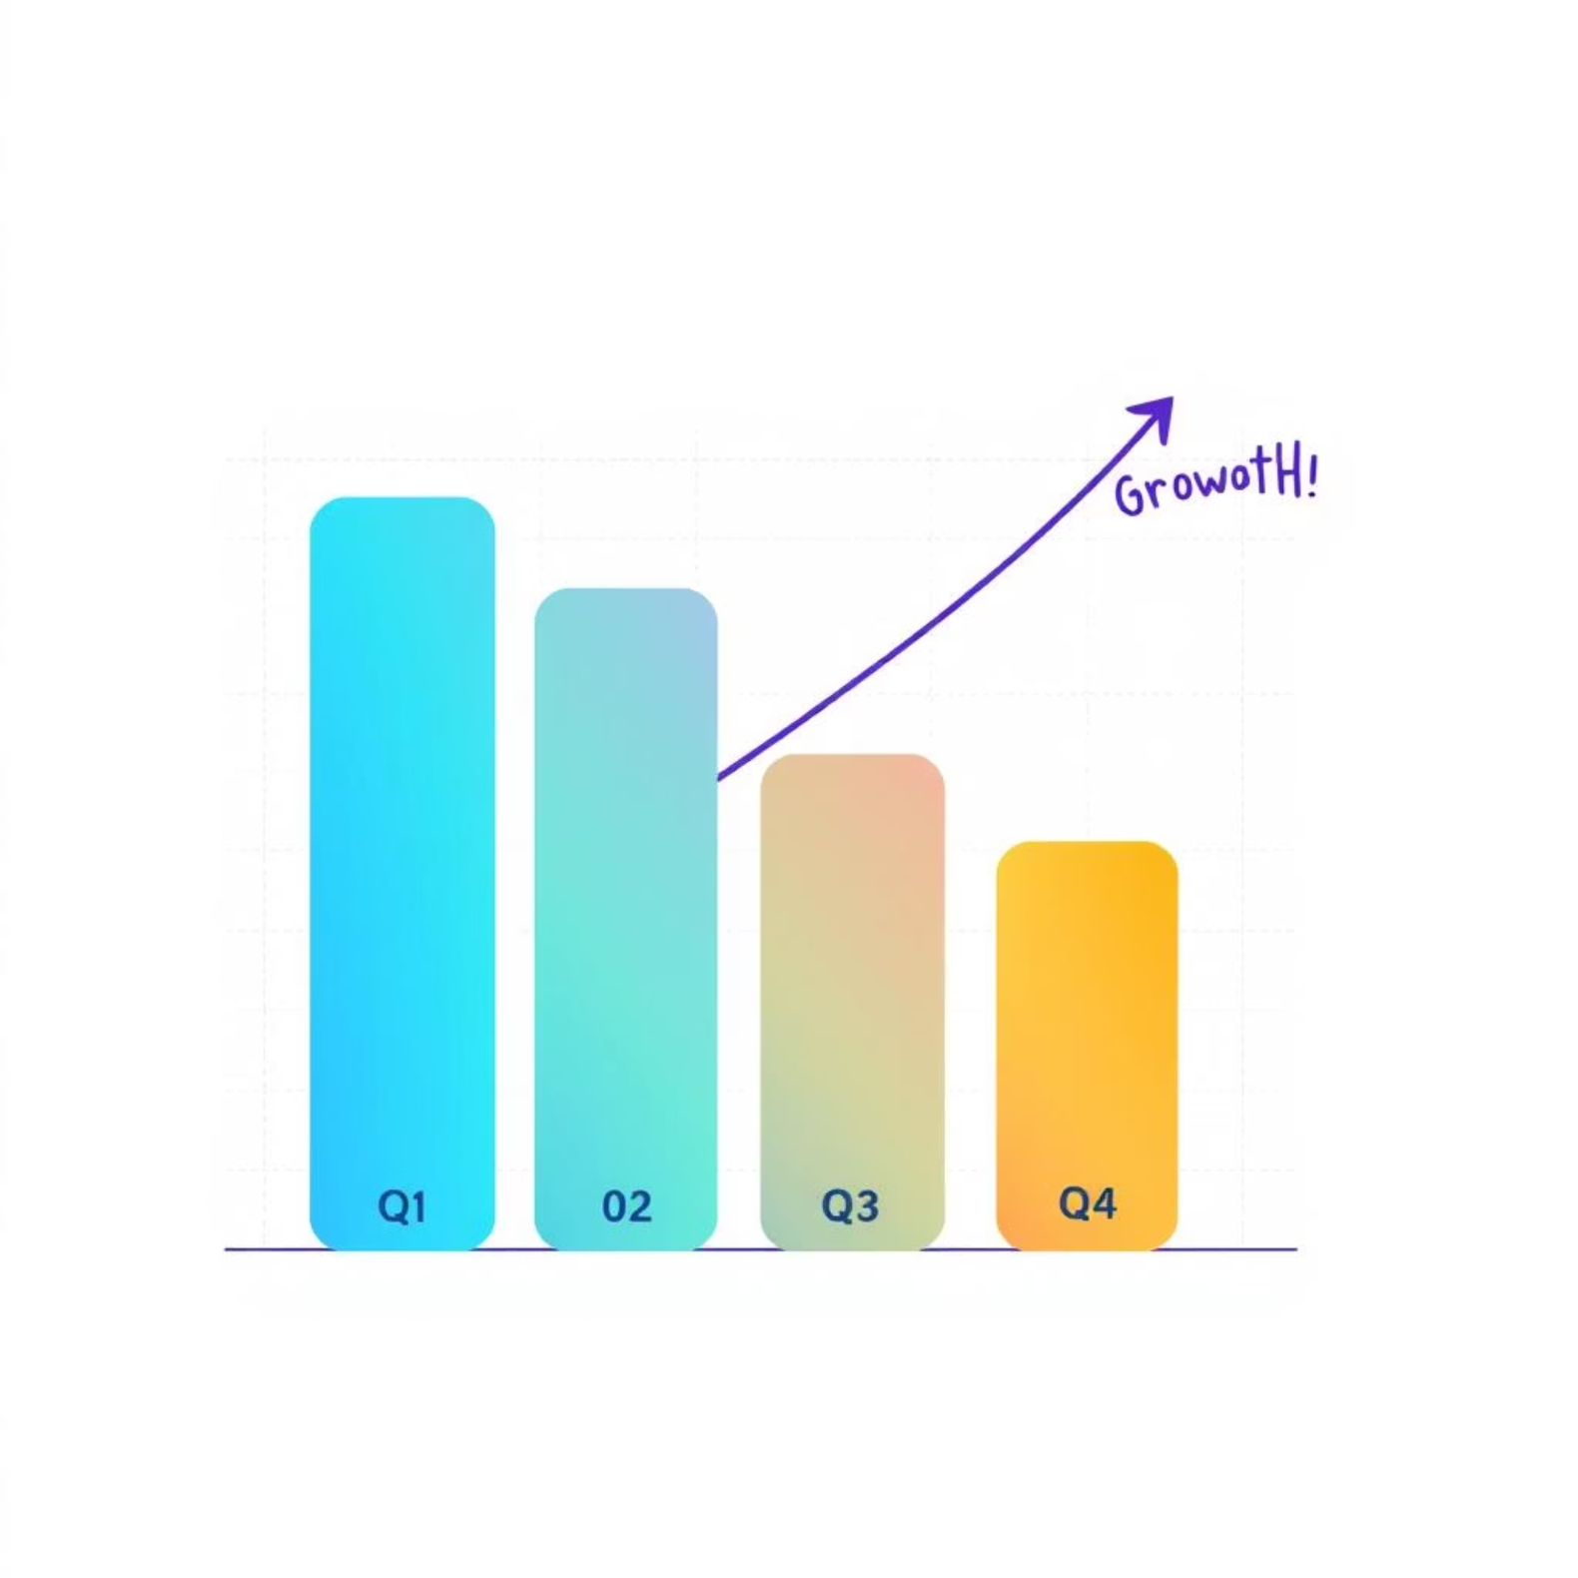
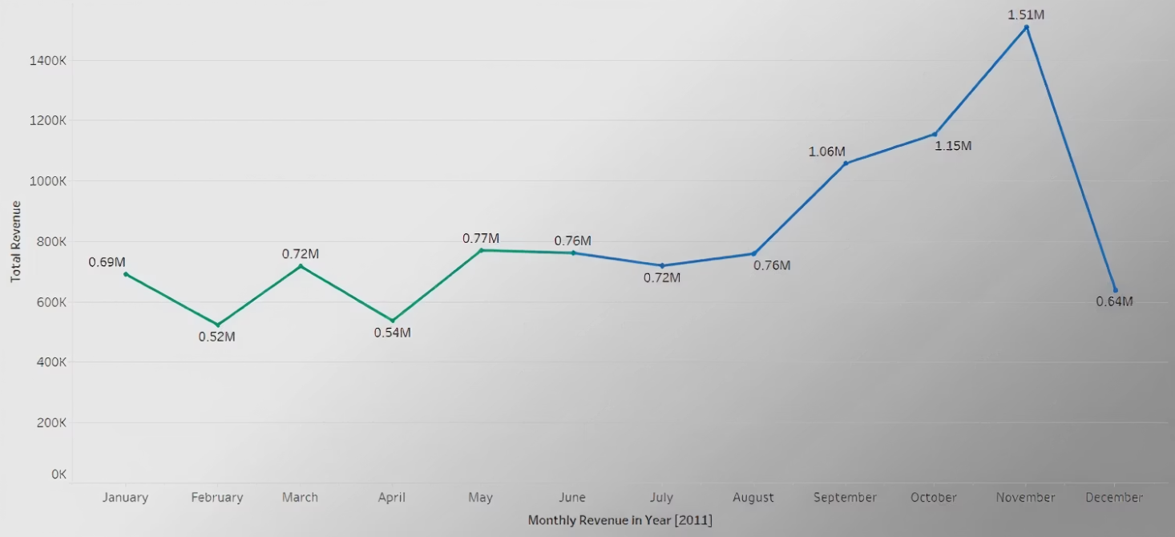
Q1: Monthly Revenue Trend (2011)
This line chart illustrates our monthly revenue for 2011, highlighting clear seasonal peaks, particularly in November and December due to holiday shopping. Such patterns are crucial for future planning of stock, promotions, and workforce allocation, enabling data-informed revenue forecasting for 2012 and beyond.

Slide 4
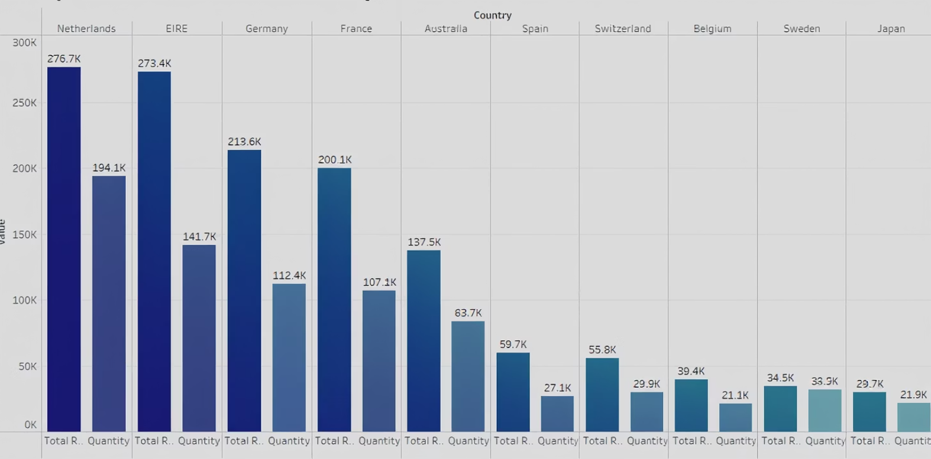




Q2: Top 10 Countries by Revenue (Excluding UK)
£276K
£213K
Netherlands
Germany
Strong revenue and high quantity sold, indicating robust demand.
Consistent high performance in both revenue and units.
This chart compares the top 10 countries by revenue, excluding the UK to highlight international growth. Including both revenue and quantity sold offers a dual perspective, helping prioritize geographic marketing strategies and identify high-volume, high-revenue regions for focused campaigns.
£200K
£137K
France
Australia
Solid market presence with good unit volume.
Emerging market with significant growth potential.

Slide 5
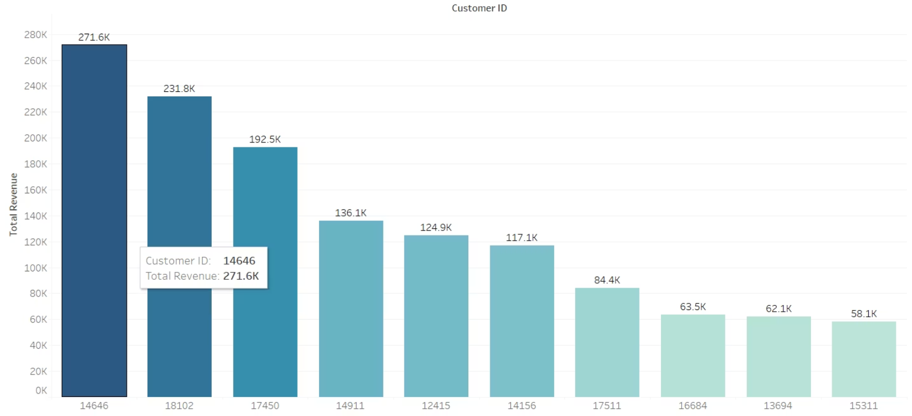
Q3: Top 10 Customers by Revenue
This chart identifies our top 10 customers by total revenue, highlighting our key revenue drivers. Prioritizing these customers with custom offers, loyalty benefits, or personal account management is essential for sustained growth, ensuring proactive engagement and retention of our top-tier clients.

Slide 6
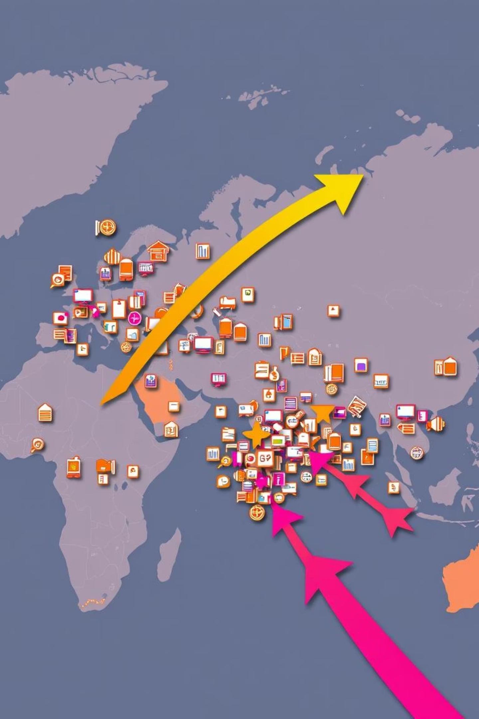



Q4: Product Demand by Country (Excluding UK)
High Demand Nations
Countries like the Netherlands, Germany, and France show significant product demand based on quantity sold, presenting robust market expansion opportunities.
Supply Chain Optimisation
This data supports decisions on where to strategically launch new products, optimise supply chain logistics, and develop targeted local partnerships.
Strategic Investment
Identifies markets already performing well, which could benefit from further investment in marketing, fulfillment centres, or localised collaborations.

Slide 7

Summary & Strategic Recommendations
1
Strategic Planning
Seasonal revenue patterns highlight the need for proactive planning around key months.
2
Global Growth
Non-UK markets are driving strong revenue and offer significant room for targeted growth.
3
Customer Loyalty
Top customers should be nurtured with retention strategies to ensure long-term profitability.
4
Market Expansion
High-demand regions outside the UK are strong candidates for market expansion and investment.

Slide 8

Next Steps & Discussion
Thank you for your time. These visuals form the basis for data-driven strategic discussions moving forward. I am happy to walk through any of the visuals in detail or discuss how we can turn these insights into operational strategies and scaled for future use through automation in Tableau dashboards or Power BI.

